Slide 1
Toxic Comment Classification
최종발표
(김지현, 이상열, 윤상필, 박희준, 오영택)

Slide 2

Overview
In this competition, you’re challenged to build a multi-headed model that’s capable of detecting different types of of toxicity like threats, obscenity, insults, and identity-based hate better than Perspective’s current models. You’ll be using a dataset of comments from Wikipedia’s talk page edits.
Evaluation:
the mean column-wise ROC AUC

Slide 3
Data
id : the unique Id of comment with hash format
comment_text : The actual text contents
toxic, severe_toxic, obscene, threat, insult, identity_hate : the labels of comments
Total number of comments in the training data : 159571
Total number of comments in the test data : 153164
 | id | comment_text | toxic | severe_toxic | obscene | threat | insult | identity_hate
0 | 0000997932d777bf | Explanation\nWhy the edits made under my usern... | 0 | 0 | 0 | 0 | 0 | 0
1 | 000103f0d9cfb60f | D'aww! He matches this background colour I'm s... | 0 | 0 | 0 | 0 | 0 | 0
2 | 000113f07ec002fd | Hey man, I'm really not trying to edit war. It... | 0 | 0 | 0 | 0 | 0 | 0
3 | 0001b41b1c6bb37e | "\nMore\nI can't make any real suggestions on ... | 0 | 0 | 0 | 0 | 0 | 0
4 | 0001d958c54c6e35 | You, sir, are my hero. Any chance you remember... | 0 | 0 | 0 | 0 | 0 | 0

Slide 4
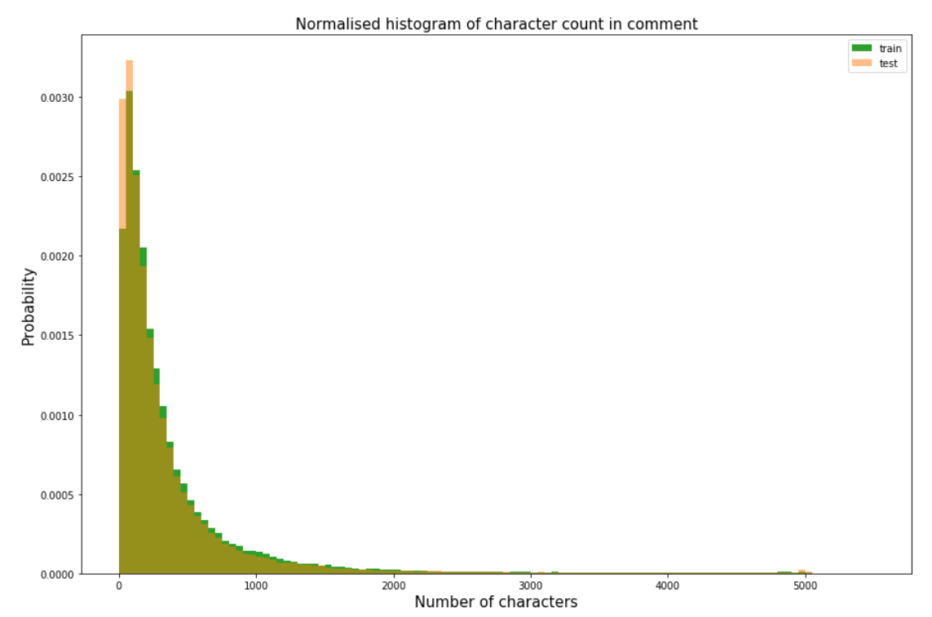
Character Based Sentence Length Dist.
mean-train 394.07 std-train 590.72 mean-test 364.88 std-test 592.49 max-train 5000.00 max-test 5000.00

Slide 5
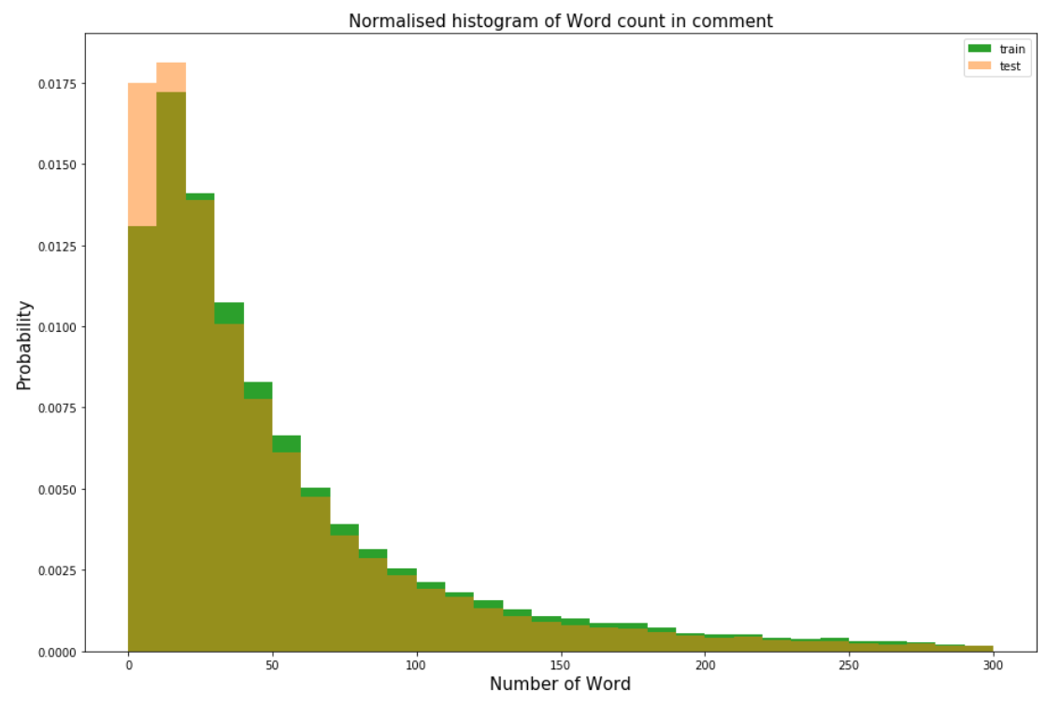
Word Based Sentence Length Dist.
mean-train 67.27 std-train 99.23 mean-test 61.61 std-test 98.96 max-train 1411.00 max-test 2321.00

Slide 6
Modeling
Requirements:
tensorflow-gpu == 1.6.0
keras == 2.1.5
Pretrained Word Embeddings:
FastText:crawl-300d-2M
Glove:glove.840B.300d

